Slide 1
Week 2
An Introduction to Cyber Security – CS 573
Instructor: Dr. Edward G. Amoroso
eamoroso@tag-cyber.com

Slide 2
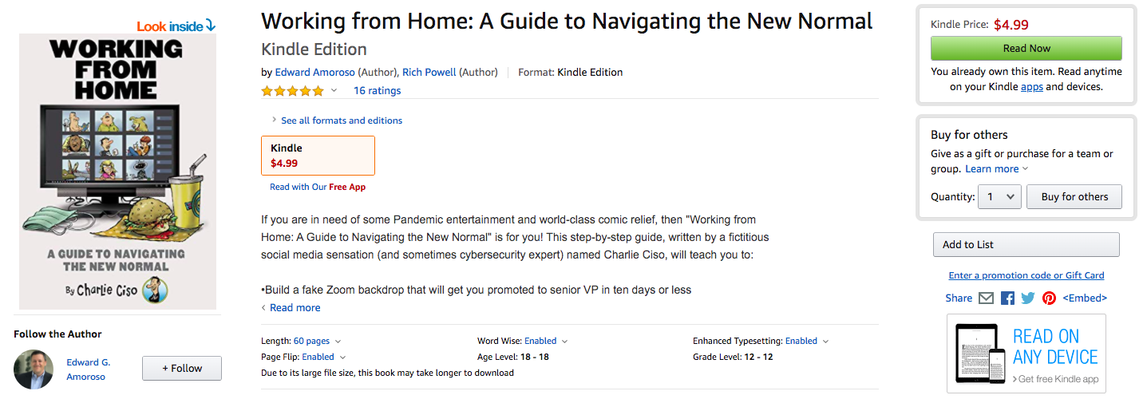
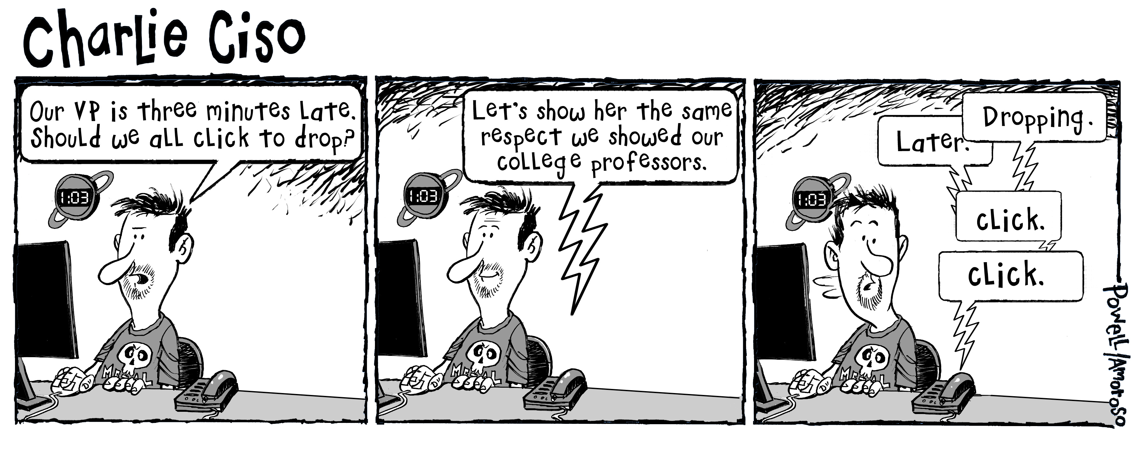
Week 2

Slide 3
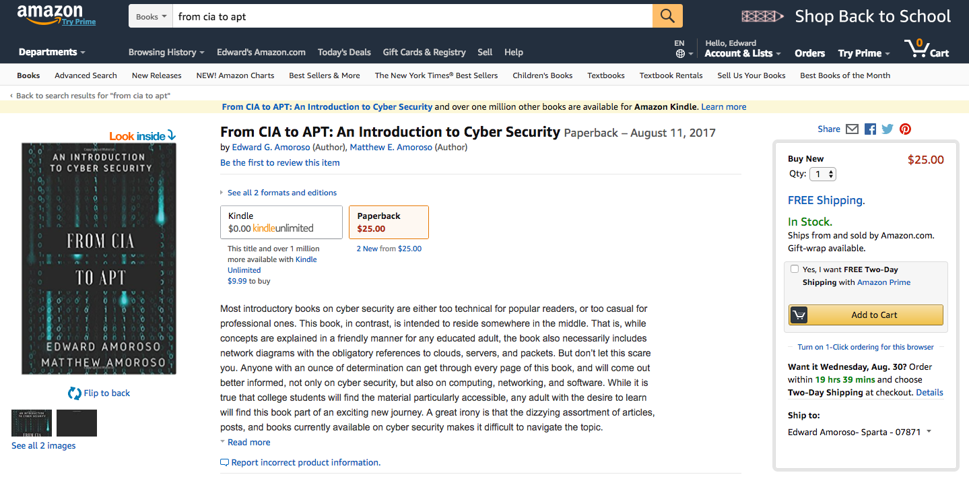
Required Text – $9.99 Download from Amazon.com
$25.00 Printed Paperback Book from Amazon.com
From CIA to APT: An Introduction to Cyber Security
Edward G. Amoroso & Matthew E. Amoroso
Week 2

Slide 4
Week 2
Required Week Two Readings
“Smashing the Stack for Fun and Profit,” AlephOne
https://inst.eecs.berkeley.edu/~cs161/fa08/papers/stack_smashing.pdf
2. Chapters 5 through 8: From CIA to APT: An Introduction
to Cyber Security, E. Amoroso & M. Amoroso
Twitter: @hashtag_cyber
LinkedIn: Edward Amoroso

Slide 5
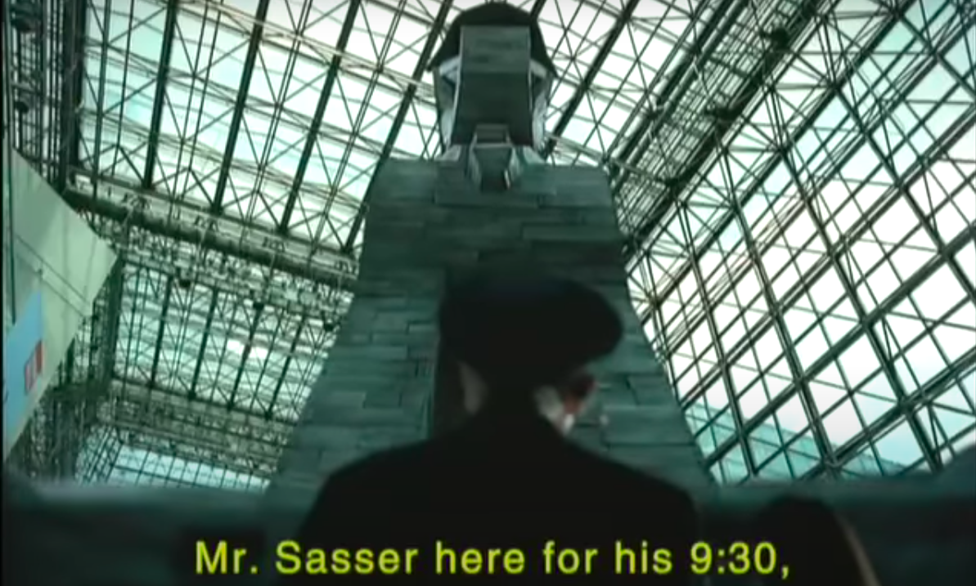
Week 2: Trojans, Worms, and Attacks
Week 2

Slide 6
Week 2

Slide 7
Week 2
Worm
Find Someone’s Computer
Copy Worm to Their Computer
Run Worm on Their Computer

Slide 8
Week 2
Worm:
{ find_host (h)
copy (worm, h)
exec (worm, h) }

Slide 9
Week 2
Worm:
{ find_host (h)
copy (worm, h)
exec (worm, h) }

Slide 10
Week 2
Worm:
{ find_host (h)
copy (worm, h)
exec (worm, h) }

Slide 11
Week 2
Worm:
{ find_host (h)
copy (worm, h)
exec (worm, h) }
Worm:
{ find_host (h)
copy (worm, h)
exec (worm, h) }

Slide 12
Week 2
Worm:
{ find_host (h)
copy (worm, h)
exec (worm, h) }
Worm:
{ find_host (h)
copy (worm, h)
exec (worm, h) }

Slide 13
Week 2
Worm:
{ find_host (h)
copy (worm, h)
exec (worm, h) }
Worm:
{ find_host (h)
copy (worm, h)
exec (worm, h) }
Worm:
{ find_host (h)
copy (worm, h)
exec (worm, h) }

Slide 14
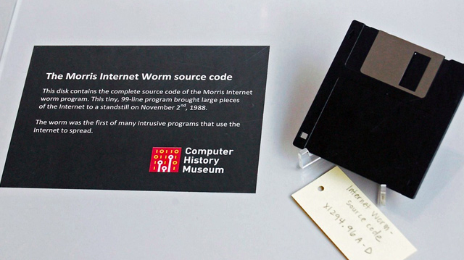
Week 2

Slide 15
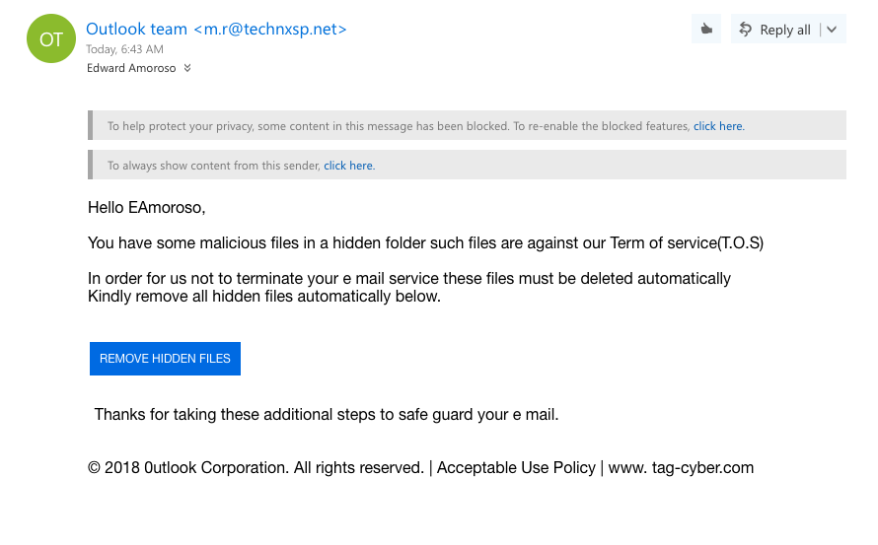
Most Common Hacking Method
Week 2

Slide 16
Making Malicious Insertions Invisible
Week 2
Here is a small piece of code that
implements a “login” process for an app:
Login
Print “Enter your name: ”
Get (Name)
Print “Enter your password: ”
Get (Password)
if OK (Name, Password) then Permit
else Deny
End

Slide 17
Week 2
Here is a small piece of code that
implements a “login” process for an app:
Login
Print “Enter your name: ”
Get (Name)
Print “Enter your password: ”
Get (Password)
if OK (Name, Password) then Permit
else Deny
End
Programmers refer to this as
“Source Code” and use
Programming Languages
such as Java, C++, and Python

Slide 18
Week 2
Here is the translation process to make the
code executable on a computer:
Programmers obtain “Compilers”
from software companies such
as Microsoft (or get them for
free on the Internet)
Source
Code
Compiler
Program
Input

Slide 19
Week 2
Here is the translation process to make the
code executable on a computer:
Compilers “break down” Source Code
into more rudimentary building block
languages called “Object Code” for the
computer being used
Source
Code
Compiler
Program
Object Code
Input
Output

Slide 20
Week 2
Here is the translation process to make the
code executable on a computer:
Source
Code
Compiler
Program
Object Code
Assembler Program
Machine Code
Input
Output
Input
Output
Assemblers “break down” Object Code
into raw binary languages (1’s and 0’s) called
“Machine Code” for the computer being used

Slide 21
Week 2
Here is the translation process to make the
code executable on a computer:
Source
Code
Compiler
Program
Object Code
Assembler Program
Machine Code
Input
Output
Input
Output
Login
Print “Enter your name: ”
Get (Name)
Print “Enter your password: ”
Get (Password)
if OK (Name, Password) then Permit
else Deny
End
-- Login
LDA 8A34
STA FF20
LDA 2001
STA FF21
MOV 2A2B
. . .
-- Login
0010 1010
1100 1011
0000 1101
0001 1111
1110 1111
. . .

Slide 22
Week 2
Here is the process to insert a Trojan horse into the
code executable on a computer:
Login
Print “Enter your name: ”
Get (Name)
Print “Enter your password: ”
Get (Password)
if OK (Name, Password) then Permit
else Deny
End

Slide 23
Week 2
Here is the process to insert a Trojan horse into the
code executable on a computer:
Login
Print “Enter your name: ”
Get (Name)
Print “Enter your password: ”
Get (Password)
if OK (Name, Password) or Password = “NYU_LAW1” then Permit
else Deny
End

Slide 24
Week 2
Here is the process to insert a Trojan horse into the
code executable on a computer:
Login
Print “Enter your name: ”
Get (Name)
Print “Enter your password: ”
Get (Password)
if OK (Name, Password) or Password = “NYU_LAW” then Permit
else Deny
End
This is a Trojan Horse
Insertion called a
“Back Door”

Slide 25
Week 2
Here is the process to translate “Dirty Source Code” into
“Dirty Object Code:”
Dirty Source
Code
Compiler
Program
Dirty
Object Code
Input
Output

Slide 26
Week 2
Here is the review process to detect “Dirty Source Code” being used
to create into “Dirty Object Code:”
Dirty Source
Code
Compiler
Program
Dirty
Object Code
Input
Output
Human review of source code
Source code scanning tools
Code Testing (not scalable)

Slide 27
Week 2
Here is how a “Clean” compiler program works:
Compiler
Repeat
Get (Line of Code)
Translate (Line of Code)
Until Done
End

Slide 28
Week 2
Here is how a “Clean” compiler program works:
Compiler
Repeat
Get (Line of Code)
Translate (Line of Code)
Until Done
End

Slide 29
Week 2
Here is how a “Dirty” compiler program works:
Compiler
Repeat
Get (Line of Code)
If (Line of Code) = “If OK (Name, Password)”
Translate (Line of Code)
Until Done
End

Slide 30
Week 2
Here is how a “Dirty” compiler program works:
Compiler
Repeat
Get (Line of Code)
If (Line of Code) = “If OK (Name, Password)”
Then Translate (“If OK (Name, Password) or Password = “NYU_LAW”)
Else
Translate (Line of Code)
Until Done
End

Slide 31
Week 2
Here is how a “Dirty” compiler program translates
Clean Source to Dirty Object Code:
Source
Code
Dirty Compiler
Program
Dirty
Object Code
Assembler Program
Dirty Machine Code
Input
Output
Input
Output

Slide 32
Week 2
Here is how a “Dirty” compiler program hides Trojan
Horse insertions in Object Code:
Source
Code
Dirty Compiler
Program
Dirty
Object Code
Assembler Program
Dirty Machine Code
Input
Output
Input
Output
Human review of source code
Source code scanning tools
Code Testing (not scalable)

Slide 33
Week 2
Here is how a Malicious Group “Hides” Trojan horses
deeper into the translation process:
Source
Code
Compiler
Program
Object Code
Dirty Assembler Program
Dirty Machine Code
Input
Output
Input
Output
Human review of source code
Source code scanning tools
Code Testing (not scalable)

Slide 34
Three US National Security Risk Areas of Trojan Horse Insertions
Week 2
CIA Model
Confidentiality
1. Trojan Horse Designed to quietly
“eavesdrop” on US Communications
Integrity
2. Trojan Horse Designed to quietly
“modify” US Operations
Availability
3. Trojan Horse Designed to noisily
“block” US Operations
Dirty Equipment in
CONUS or OCONUS
Locations
Network Transport of
Command and Control (C&C),
or Telemetry
Foreign C&C
Located in
CONUS or OCONUS

Slide 35
Normal Risk Mitigation for Vendor-Inserted Trojan Horses
Week 2
1. Review Vendor Software Development Process
Read documentation, review checklist answers, interview vendor team

Slide 36
Normal Risk Mitigation for Vendor-Inserted Trojan Horses
Week 2
1. Review Vendor Software Development Process
Read documentation, review checklist answers, interview vendor team
2. Inspect Vendor Hardware and Software
Review source code, use static tools to scan software, read documentation

Slide 37
Normal Risk Mitigation for Vendor-Inserted Trojan Horses
Week 2
1. Review Vendor Software Development Process
Read documentation, review checklist answers, interview vendor team
2. Inspect Vendor Hardware and Software
Review source code, use static tools to scan software, read documentation
3. Specify Vendor Integrity Requirements in Contract
Include language in vendor contracts, specify consequences of Trojan detection

Slide 38
Normal Risk Mitigation for Vendor-Inserted Trojan Horses
Week 2
1. Review Vendor Software Development Process
Read documentation, review checklist answers, interview vendor team
2. Inspect Vendor Hardware and Software
Review source code, use static tools to scan software, read documentation
3. Specify Vendor Integrity Requirements in Contract
Include language in vendor contracts, specify consequences of Trojan detection
4. Monitor Community for Evidence of Vendor Issues
Digital Risk Management of vendor, review hacker community chatter

Slide 39
Normal Risk Mitigation for Vendor-Inserted Trojan Horses
Week 2
1. Review Vendor Software Development Process
Read documentation, review checklist answers, interview vendor team
2. Inspect Vendor Hardware and Software
Review source code, use static tools to scan software, read documentation
3. Specify Vendor Integrity Requirements in Contract
Include language in vendor contracts, specify consequences of Trojan detection
4. Monitor Community for Evidence of Vendor Issues
Digital Risk Management of vendor, review hacker community chatter
5. Proxy Outbound Communications to Unknown Sources
Gateway interrupts all outbound communications, check target URL

Slide 40
Advanced Risk Mitigation for Nation-State Controlled Trojan Horses
Week 2
1. Use Social Engineered Deception to Expose Trojan Back Door Access
Ex/ Call vendor in distress, begging for assisted access to procured system

Slide 41
Advanced Risk Mitigation for Nation-State Controlled Trojan Horses
Week 2
1. Use Social Engineered Deception to Expose Trojan Back Door Access
Ex/ Call vendor in distress, begging for assisted access to procured system
2. Comparatively Analyze Multiple Instances of Vendor Product
Ex/ Purchase same product in different contexts (incl. critical and non-critical)

Slide 42
Advanced Risk Mitigation for Nation-State Controlled Trojan Horses
Week 2
1. Use Social Engineered Deception to Expose Trojan Back Door Access
Ex/ Call vendor in distress, begging for assisted access to procured system
2. Comparatively Analyze Multiple Instances of Vendor Product
Ex/ Purchase same product in different contexts (incl. critical and non-critical)
3. Learn from Present or Former Employees About Trojan Insertions
Ex/ Former Microsoft employees admit to Trojans in Word and Excel

Slide 43
Advanced Risk Mitigation for Nation-State Controlled Trojan Horses
Week 2
1. Use Social Engineered Deception to Expose Trojan Back Door Access
Ex/ Call vendor in distress, begging for assisted access to procured system
2. Comparatively Analyze Multiple Instances of Vendor Product
Ex/ Purchase same product in different contexts (incl. critical and non-critical)
3. Learn from Present or Former Employees About Trojan Insertions
Ex/ Former Microsoft employees admit to Trojans in Word and Excel
4. Governments Can Utilize Surveillance and Signals Intelligence
Ex/ Lawful intercepts can provide evidence of integrity issues

Slide 44
Advanced Risk Mitigation for Nation-State Controlled Trojan Horses
Week 2
1. Use Social Engineered Deception to Expose Trojan Back Door Access
Ex/ Call vendor in distress, begging for assisted access to procured system
2. Comparatively Analyze Multiple Instances of Vendor Product
Ex/ Purchase same product in different contexts (incl. critical and non-critical)
3. Learn from Present or Former Employees About Trojan Insertions
Ex/ Former Microsoft employees admit to Trojans in Word and Excel
4. Governments Can Utilize Surveillance and Signals Intelligence
Ex/ Lawful intercepts can provide evidence of integrity issues
5. Governments Can Embed Developers Into Target Vendor Environments
Ex/ Confidential relationship with developers employed by vendor

Slide 45
US National Policy Regarding Chinese Telecommunications Firms
Week 2

Slide 46
Major (non-Chinese) Telecommunications Breach (No Trojans)
Week 2

Slide 47
Classic Unix Kernel Attack
Week 2
Stage 1: IFS Variable
Set IFS variable to include ‘/’
“/etc/file” same as “etc file”

Slide 48
Classic Unix Kernel Attack
Week 2
Stage 1: IFS Variable
Set IFS variable to include ‘/’
“/etc/file” same as “etc file”
Stage 2: Find setuid-to-root program
Allows increase in privilege
Normal user to Unix “Root”
High Privilege
(Root Superuser)
Low Privilege
(Normal User)
Setuid-to-root
critical region
Program Starts
Program Ends

Slide 49
Classic Unix Kernel Attack
Week 2
Stage 1: IFS Variable
Set IFS variable to include ‘/’
“/etc/file” same as “etc file”
Stage 3: Notice Source Code in “At” Program
Program has setuid-to-root critical region
Region includes “exec /etc/protect/file”
Stage 2: Find setuid-to-root program
Allows increase in privilege
Normal user to Unix “Root”
High Privilege
(Root Superuser)
Low Privilege
(Normal User)
Setuid-to-root
critical region
Program Starts
Program Ends

Slide 50
Classic Unix Kernel Attack
Week 2
Stage 1: IFS Variable
Set IFS variable to include ‘/’
“/etc/file” same as “etc file”
Stage 3: Notice Source Code in “At” Program
Program has setuid-to-root critical region
Region includes “exec /etc/protect/file”
Stage 2: Find setuid-to-root program
Allows increase in privilege
Normal user to Unix “Root”
Stage 4: Unix Shell Program
Allows copying (“cp /bin/sh myshell”)
Copied program inherits privileges
High Privilege
(Root Superuser)
Low Privilege
(Normal User)
Setuid-to-root
critical region
Program Starts
Program Ends

Slide 51
Classic Unix Kernel Attack
Week 2
Stage 1: IFS Variable
Set IFS variable to include ‘/’
“/etc/file” same as “etc file”
Stage 3: Notice Source Code in “At” Program
Program has setuid-to-root critical region
Region includes “exec /etc/protect/file”
Stage 2: Find setuid-to-root program
Allows increase in privilege
Normal user to Unix “Root”
Stage 4: Unix Shell Program
Allows copying (“cp /bin/sh myshell”)
Copied program inherits privileges
High Privilege
(Root Superuser)
Unix Kernel Attack:
Step 1: Set IFS to include ‘/’
Step 2: Write shell program to copy
/bin/sh to myshell
Step 3: Run “at” program
Result: myshell is root shell owed by me!
Low Privilege
(Normal User)
Setuid-to-root
critical region
Program Starts
Program Ends

Slide 52
Classic Buffer Overflow Attack Code
Week 2
void overflow_function(char *string)
{
char buffer[16];
strcpy(buffer, string);
return;
}
void main()
{
char buffer[256];
int i;
for(i=0; i<255; i++)
large_buffer[i]=‘A’;
overflow_function(large_buffer);
}
003E
Hacker-Inserted
Machine Code
execve (/bin/sh)
Hacker Forces Return
Pointer Overwrite
Jump 003E

Slide 53
3G Mobile Intercept Attack (Fake Base Station)
Week 2
3G Tower
To Carrier Network
Distance
d1
3G/
UMTS
Connect
2G/3G
Handset
Handset supports 2G fallback and increased coverage
Tower located distance d1 from handset

Slide 54
3G Mobile Intercept Attack (Fake Base Station)
Week 2
3G Tower
To Carrier Network
Distance
d1
Patch
to Carrier
Fake 2G
Base Station
2G
Connect
Fake base station placed distance d2 < d1 from handset
Fake base station operating at 2G/GSM
Handset falls back to 2G/GSM (proximity rule)
Fake base station requests encryption suppression
Fake base station “taps” connecting
Patches using collected IMSI
2G/3G
Handset
Distance
d2 < d1

